Slide 1


Slide 2

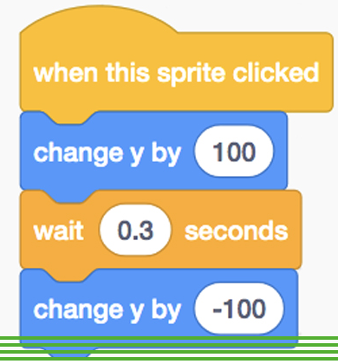
Functions

Slide 3
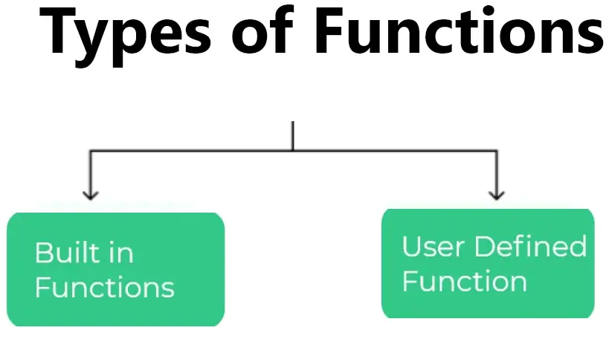
( According to creation )

Slide 4
Built-in Functions
Pre-written functions that come with the programming language
Readily available for you to use without needing to define them yourself
Handle common tasks like mathematical operations, string manipulation and input/output

Slide 5
User-defined Functions
Create yourself to address specific needs within your program
Parts :
name
what it does
what data it can receive as inputs (parameters) - optional
what it should output (return value) - optional

Slide 6

What is the concept of Built-in functions?
Why user-defined functions are required?

Slide 7
Functions
A block of organized, reusable code that performs a single action
Helps break programs into smaller, modular, and manageable chunks
Simplifies debugging and testing

Slide 8
Defining Function
def function_name(parameters):
# Function body (statements to be executed)
return value # optional return statement
def : Keyword to define a function.
function_name: Descriptive name for the function
parameters (optional): List of variables to receive input values
Function body: Indented block of code that executes when the function is called.
return (optional): Send a value back from the function to the caller.

Slide 9
Calling a Function
function_name(arguments)
Call functions using their names and optional arguments

Slide 10

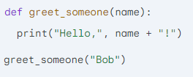
Example

Slide 11
What is the body of function?
How can we use the function when required?

Slide 12


Scope of Variables
Where a variable is accessible/visible
Local Variable: Defined within a function and accessible only within that function
Global Variable: Defined outside any function and accessible from anywhere in the program

Slide 13
What is the concept of scope of a variable?
How variable scope helps in programming?

Slide 14

Functions return values
“return” statement used for this purpose
Used to send a value back from the function to the caller
Can return any data type (numbers, strings, lists, etc.)

Slide 15

Create functions of all types according to your choice

Slide 16
HOME
Think of an app of your choice
Create at least 3 different functions you find to be required

